Slide 1




Catch Them All!

Slide 2



About us!
Amber Venes
Earl Lewis
Zachary Dallas
Robert Williard

Slide 3


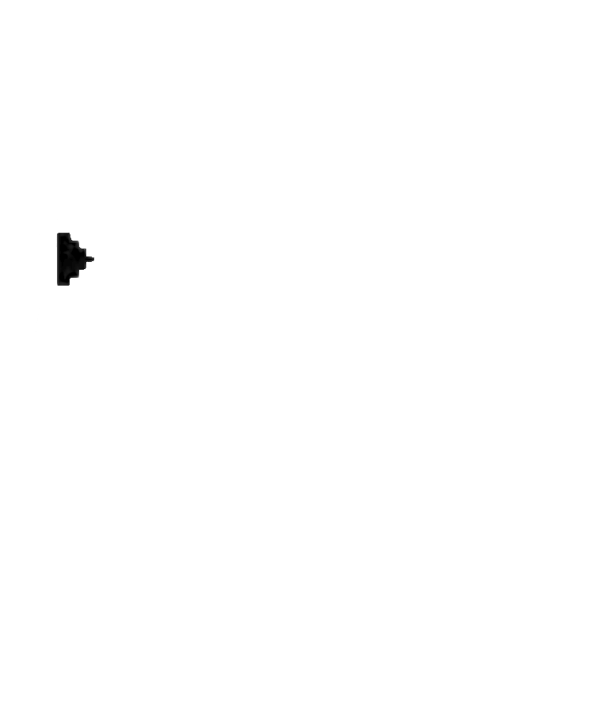
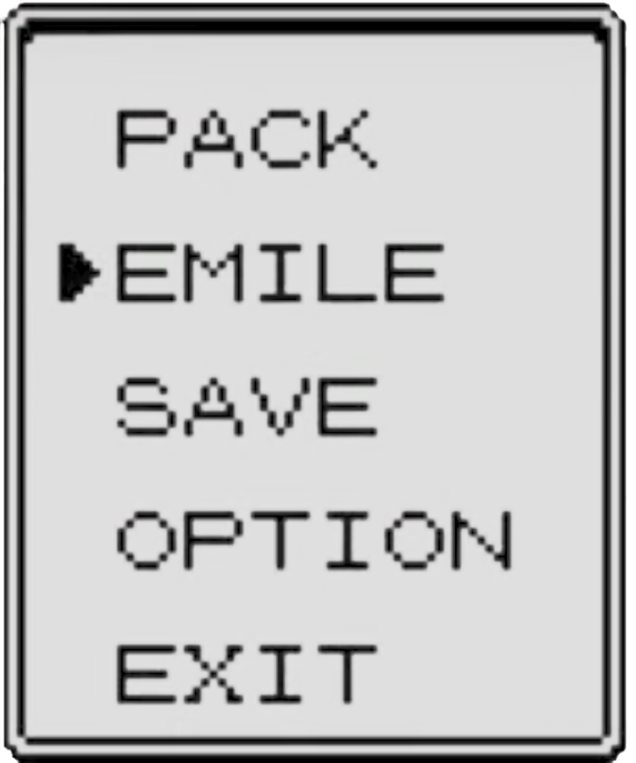


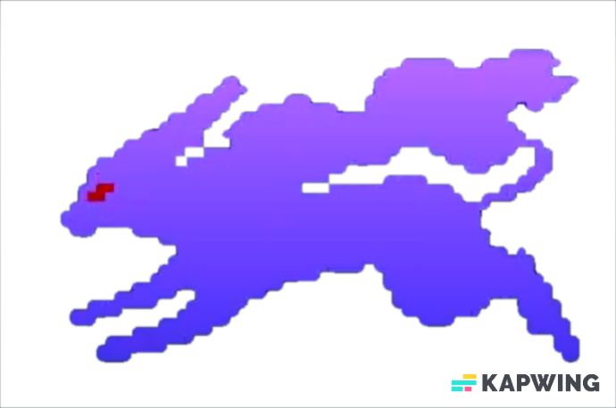
What's in our Data?
Why did we pick it?
Our dataset consists of a total 1014 unique pokemon from 8 generations (1996-2019).
It contains information from the games such as the stats (attack, defense, etc), ability, type, species, catch rate, base friendship, growth rate and gender.
Catch rate
Stats
Type, Height & Weight
We picked this dataset mostly because of the usability rating and the amount of data it provides. Pokemon is nostalgic and has a lot of data to manipulate.

Slide 4



Design concept/Inspiration
Data Cleaning
For our visuals and dash we decided to choose a wide range of bright colors because we felt it best represented pokemon themselves. For the slides we decided to represent the games.
Our dataset was very clean and required very minimal amount of cleaning. The “Type” column had to change from multiple to just one.
Pokémon Base Stats Dataset (kaggle.com)

Slide 5

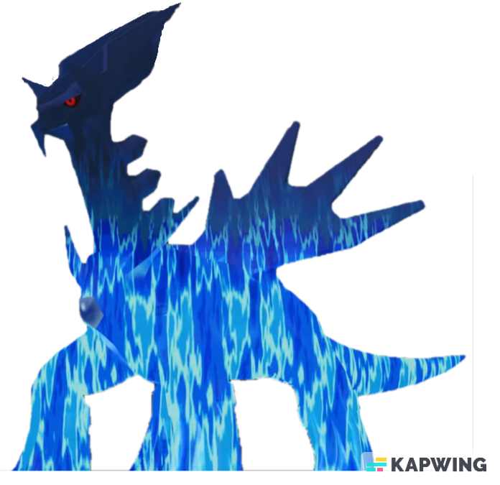
What are the top 5 easiest pokemon to catch and what are the top 5 most difficult to catch?
Based on generation. what generation is the top based on the average attack, defense, speed, special attack, special defense?
What type of pokemon has the most and what type has the least?
Notes:
Looking at the data based on total stalls it looks like the USA or CHINA is one of the best places to own a tesla
Areas to avoid for owning teslas are south america and africa due to there being no publicly available superchargers
The usa and china are two of the fastest growing areas with over 19k and over 10k respectively

Slide 6


Our Model
For our model we chose Random ForestRegressor
The RMSE was 66%. This is what we found to be the best vs other models

Slide 7

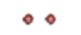
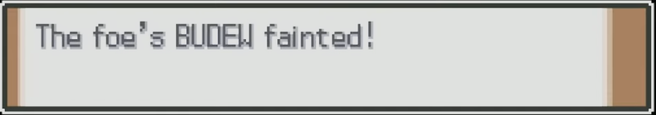
Live demo!

Slide 8

Conclusion
The top generation for the average attack, defense, special attack, and special defense is gen 7. The top generation for speed is generation 4.
Water type of pokemon and flying has the least amount.
Limitations/Bias
The catch rate does not actually determine if the pokemon will be caught
A secondary dataset had to be used to organize the pokemon into generations
The secondary type had to be removed
Future Work
Properly perfect the machine learning model so that it can predict the catch rate

Slide 9

Thank You!

